Slide 1
Values Based Education
October 2014
Widmer End CC School

Slide 2
What are values?
Values are principles that guide our thinking and behaviour
Values include: respect, honesty, care, trust, patience, empathy, love, tolerance, compassion, responsibility, simplicity, freedom and peace.

Slide 3
Values Assemblies
The school assembly is central to the development of Values Education.
It has a tremendous potential to nurture a positive school ethos that emphasises care and the pursuit of excellence. This helps the school to develop a sense of harmony.

Slide 4
Reflection Time
•Pupils are taught how to sit in a still, relaxed, alert and comfortable manner.
•Demonstrate to children how to sit: facing you, with their back and head straight but relaxed.
•Ask children to close their eyes or focus on a candle light.
•Invite children to think about someone they love, doing something they like, and so on, related to your value.
Retreat, Observe, Reflect, Act

Slide 5
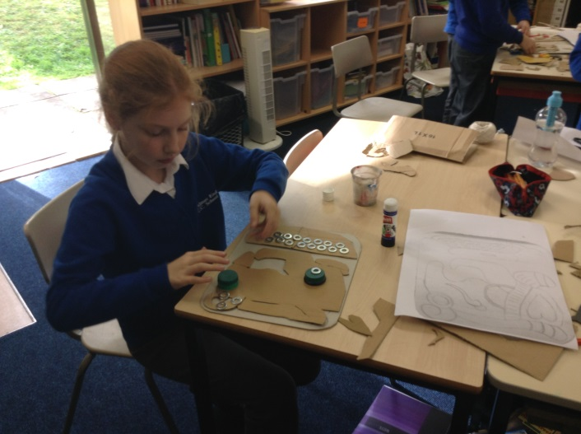
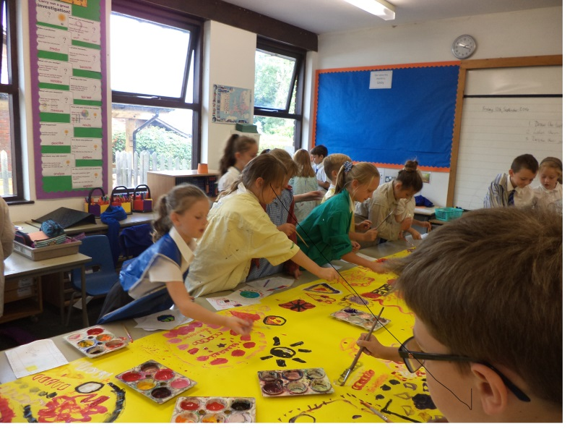
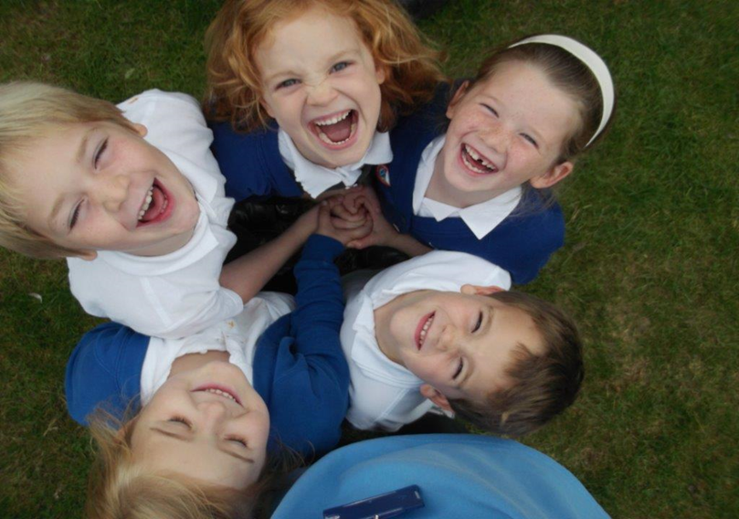
Values in class

